Slide 1
Price Discrimination with Fairness Constraints
Wafa Altuwaijri April 2022
Maxime C. Cohen, Adam N. Elmachtoub, Xiao Lei
2021 ACM Conference
on Fairness, March 2021
Online Presentations
1

Slide 2
Background
“The increased availability of consumer data and the widespread use of e-commerce has led to a discriminatory and personalized pricing strategies (Xue et al. 2015, Ye et al. 2018)”
The U.S. Civil Rights Act of 1964 and the Equal Credit Opportunity Act of 1974 protect against discrimination based on protected attributes, such as race, color, religion, sex, and national origin as well as most recently
However, several studies illustrate that there is an increasing price discrimination practices such as:
“Charles et al. (2008) show that Black individuals receive higher interest rates for auto loans”
“Larson et al. (2015) show that a test preparation provider charged Asian Americans higher prices”
2
Notes:
“In 2020 the state of New York banned gender-based price discrimination to fight against the increasing trend of large retailers selling the same product at different prices by simply changing the packaging or the product color.”
Customer Valuation meaning “show that East Asian Americans are 1.5 times more likely to purchase commercial test preparation services, which indicates that this group tends to have a higher valuation for such services. Second, this phenomenon can occur when a group of people has a higher average search cost or less bargaining intensity (Fang and Munneke 2020), so they are willing to accept higher prices to reduce the searching process (e.g., applying for a new loan). Third, a higher valuation can

Slide 3
Study’s Focuse:
In order to address price discrimination , its effects on societies, and the ambiguous guidelines on imposing fair pricing strategies, the paper considers the following questions:
“How can we model the fairness of decisions made in the context of price discrimination? Is it possible to impose several types of fairness simultaneously?”
“What is the impact of fairness constraints on the seller, customers, and society at large?”
3
Notes:
The articles investigates to what extent our fairness constraints can improve social welfare.
The paper assumes that the seller has unbiased and accurate information on customer segmentation and valuations and focuses on how to make fair pricing decisions given such information.

Slide 4
Framework:
Assumed that there is one seller and two groups. The seller needs to select a price for each group with the goal of maximizing profit
Price Fairness Definition:
Price fairness: enforces that the prices offered to the two groups are nearly equal
Demand fairness: enforces that the two groups have equal access to the product
Surplus fairness: requires that the surplus of the two groups is similar. The two groups must be equally happy
No-purchase valuation fairness imposes that the average valuation of consumers who can not afford the product is approximately the same for each group. “Two groups must be equally unhappy”
4
Notes:
Model “assumes that price discrimination occurs because of the difference in valuation distributions of the customer groups and not because of inherent racism or biases of the seller”
Demand fairness: ensure that different groups such as low-income families have equal opportunities with the high-income families to obtain a product
Surplus fairness: surplus is defined as the consumer valuation minus the price paid, and it is zero if no purchase is made.

Slide 5
Can Perfect Fairness be Achieved?
When mean valuation of both groups is not equal, it is impossible to achieve all four fairness definitions Simultaneously
Imposing fairness constraints may not necessarily increase social welfare.
For demand or surplus fairness, imposing any level of fairness will decrease social welfare
For price and no-purchase valuation fairness, imposing fairness improves social welfare.
5
Notes:
four fairness definitions:
Price fairness
Demand fairness
Surplus fairness
No-purchase valuation fairness

Slide 6
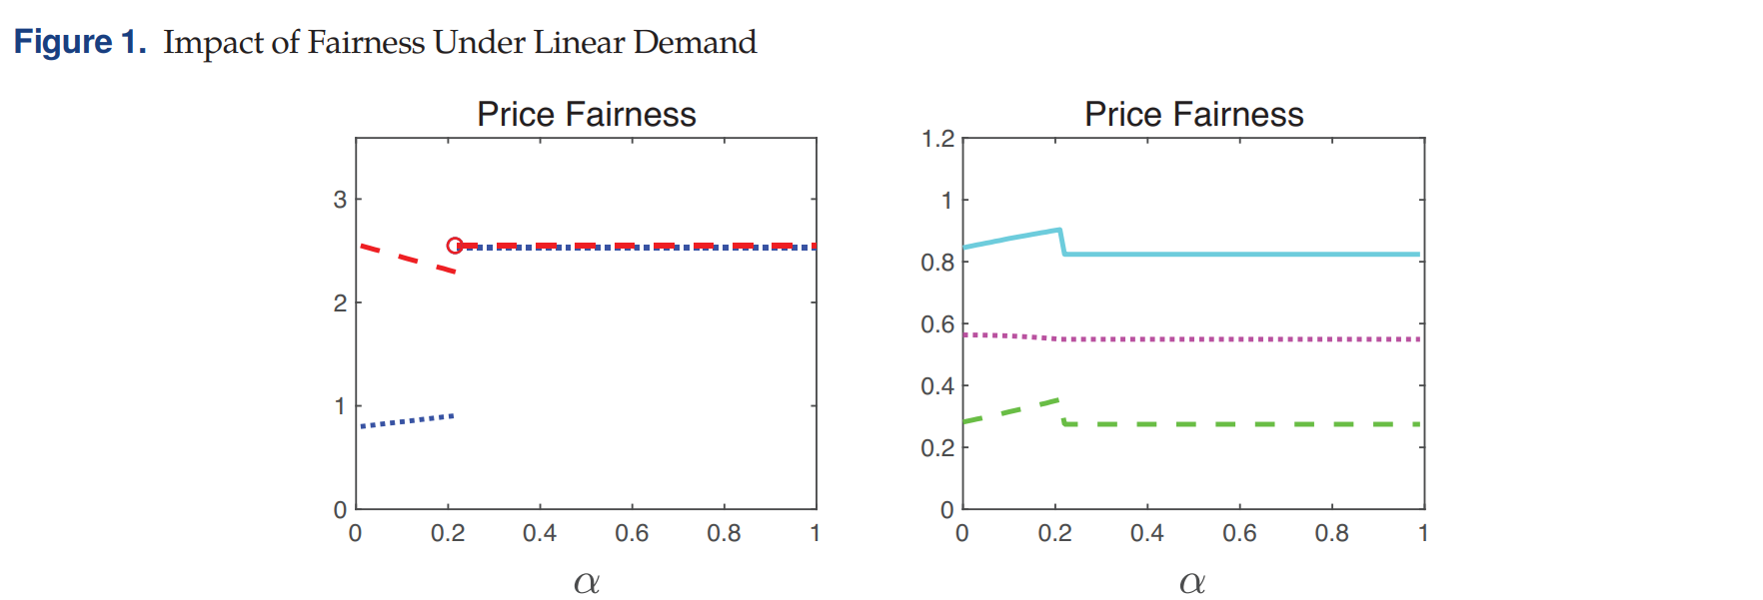
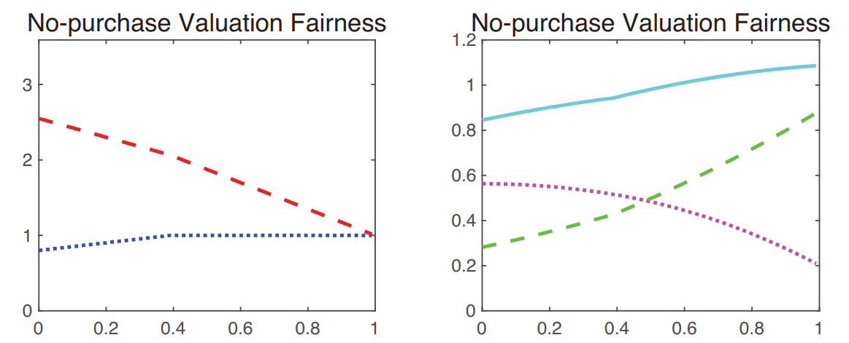
Price Fairness (Linear Demand):
No-Purchase Valuation Fairness (Linear Demand:
6
Notes:
Social welfare is increasing then suddenly drops below unconstrained fairness. Little fairness increase welfare but to much fairness lead to a loss to the seller and consumer

Slide 7
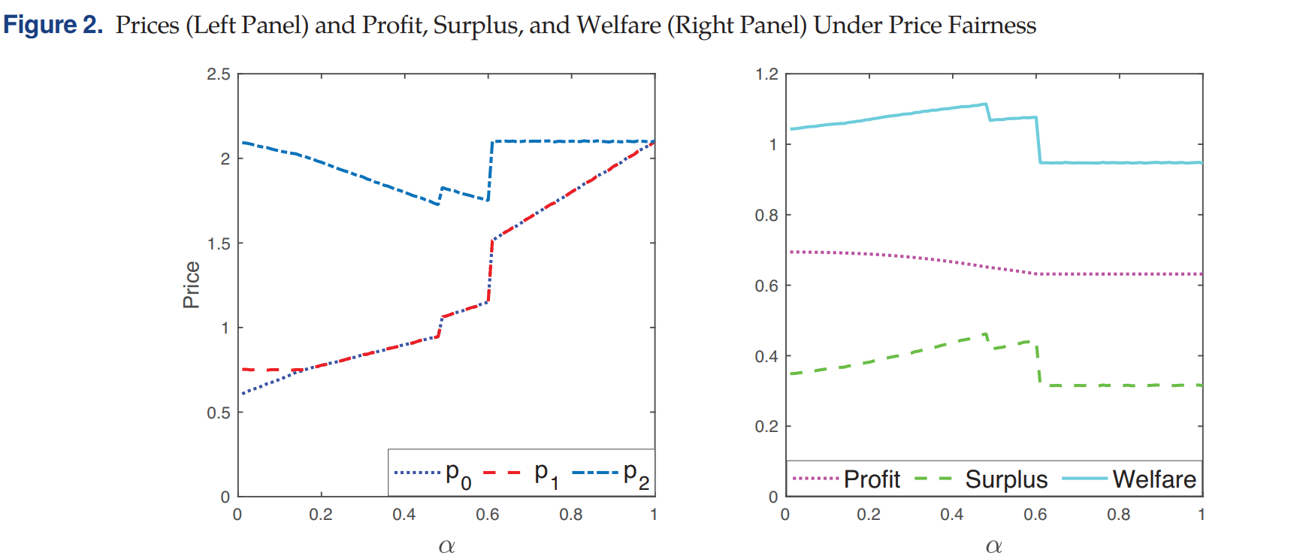
Study conducted on Multiple Groups:
7

